Slide 1

Smart Water Metering
Presented By:
Team: TechGags

Slide 2
Present Scenario
Source: Water Consumption Patterns in Domestic Households in Major Cities, Abdul Shaban, R N Sharma, Economic and Political Weekly, June 9, 2007.
Source: 'Urban Water Bengal', ILGUS

Slide 3
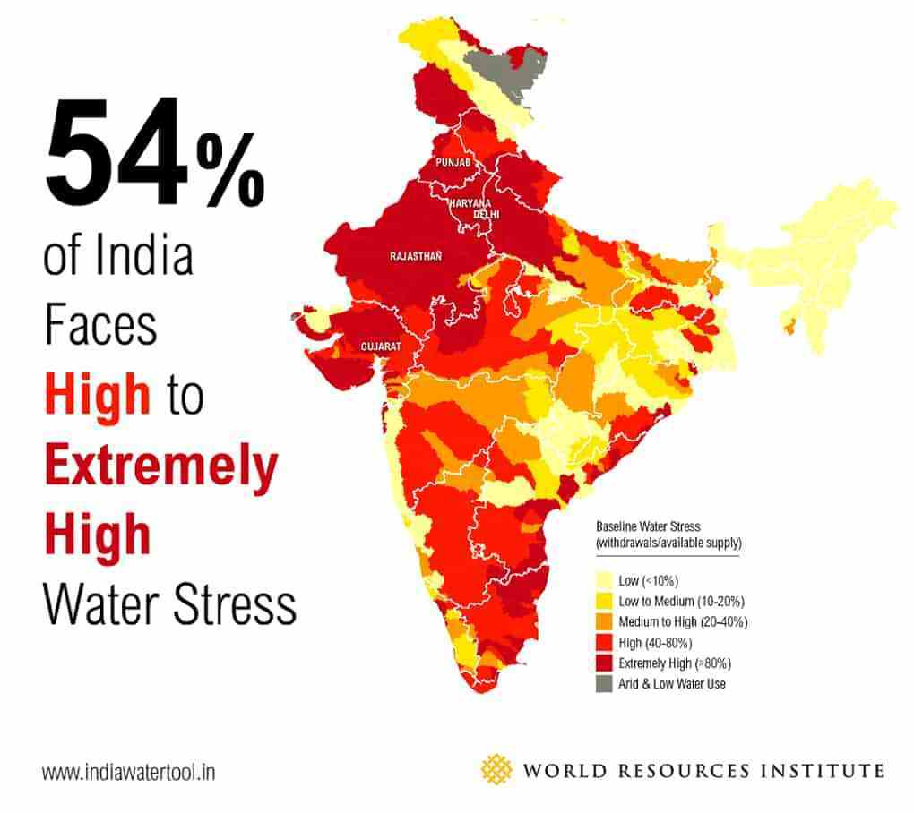
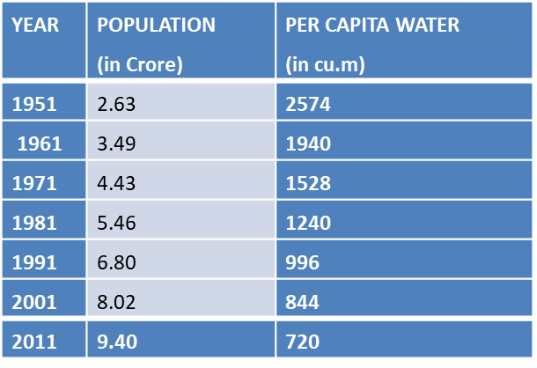
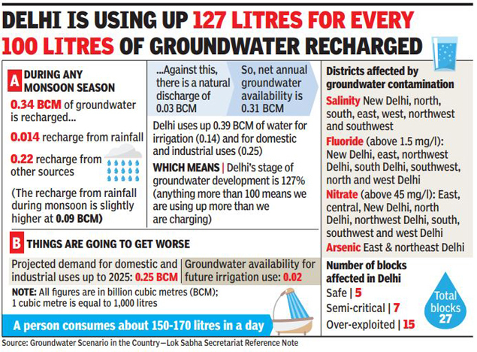
Present Scenario
Depicts the growth of population and declining per capita water for West Bengal
Source: The Status of Water Resources in West Bengal, Kalyan Rudra.
Depicts one instance of how excessively (ground) water is getting used up.
11 June 2018, Times of India
Depicts the extreme shortage of water due to repeated overuse

Slide 4
Our understanding of the challenge
Estimation of the requisite amount of water required in an area in synchronization with the infrastructural design of the area.
Designing an area specific customized tool for anomaly detection in flow rates.
Visualization of water usage data on smartphones through a cloud based platform.
Alerting any number of concerned user and other requisite authorities on anomalous water usage, in the concerned area.

Slide 5
Our Objective
Propose and deploy an autonomous system using Artificial Intelligence and Machine Learning to differentiate between normal and excessive water flow in a given area.
Collection and visualization of water consumption data for the ease of analysis.
Provide a system to alert users in case of the latter.
Generate revenue.

Slide 6
Utility of Water Meter
They help detect leaks and major faults in water pipeline distribution system.
They encourage customers to use water judiciously.
They allow a utility system to easily monitor the volume of water usage.
They make it possible to charge a tariff from customers in proportion to the amount of water they use.

Slide 7
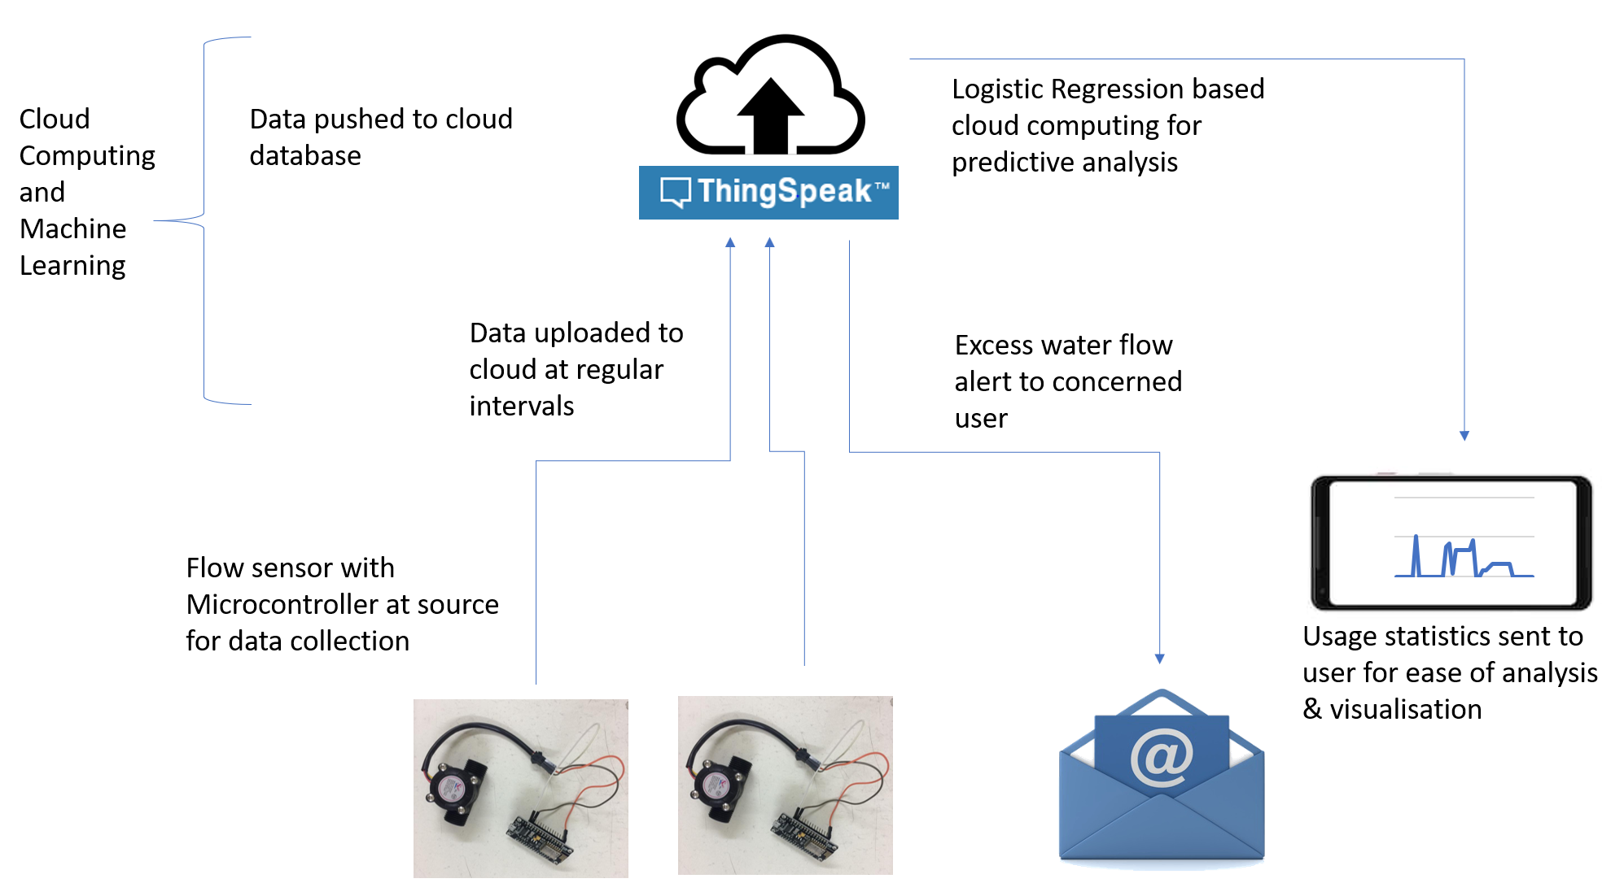
Solution Architecture

Slide 8
Detailed Work Flow
Data Acquisition from the Water Flow sensor using NodeMCU.
Connectivity with ThingSpeak Cloud platform and real-time data transmission.
Graphical visualization of the data on ThingSpeak platform w.r.t GMT timestamps.
Calculating total water flown through a particular meter in a given time.
Machine Learning Tools – Linear and Logistic Regression to analyze excessive water flow using a SVM Classifier.
System can alert if:
Excessive water usage for a particular meter based on immediate historical records.
Futuristic Prediction of excessive water flow whose accuracy will depend on volume of data collected.
Triggering alerts to concerned users through email notifications.
Solar Powered self-sustainable water meter.

Slide 9
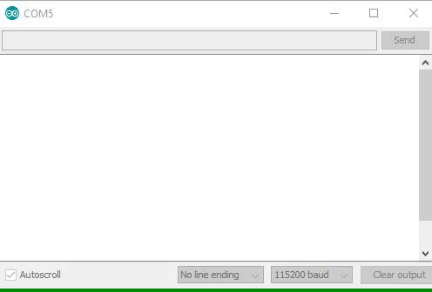
Detailed Work Flow
Data Acquisition from the Water Flow sensor using NodeMCU.
Connectivity with ThingSpeak Cloud platform and real-time data transmission.
Video to demonstrate data acquisition from water flow sensor and real-time transmission to cloud platform.

Slide 10
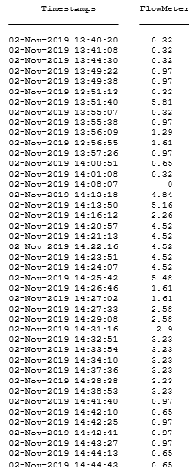
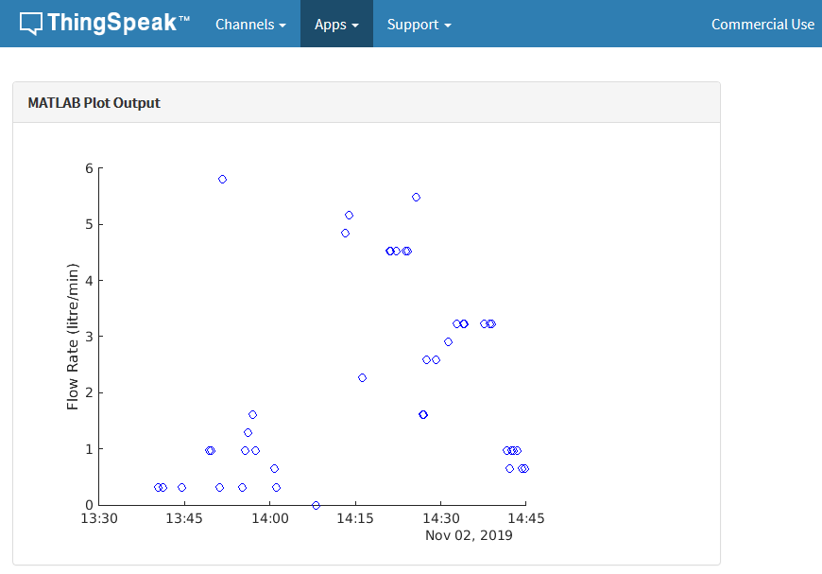
Detailed Work Flow
3. Graphical visualization of the data on ThingSpeak platform w.r.t GMT timestamps.
Visualization in Thingspeak platform as a scatter plot
Visualization in Thingspeak platform in tabular form

Slide 11
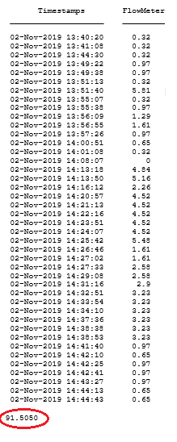
Detailed Work Flow
4. Calculating total water flown through a particular meter in a given time frame.
Calculation was done using the trapz function.
This is used to calculate the historical data of water usage for a particular meter and interpret it as normal or excessive flow.
Output from the program to calculate total water flow, in a given time frame.

Slide 12
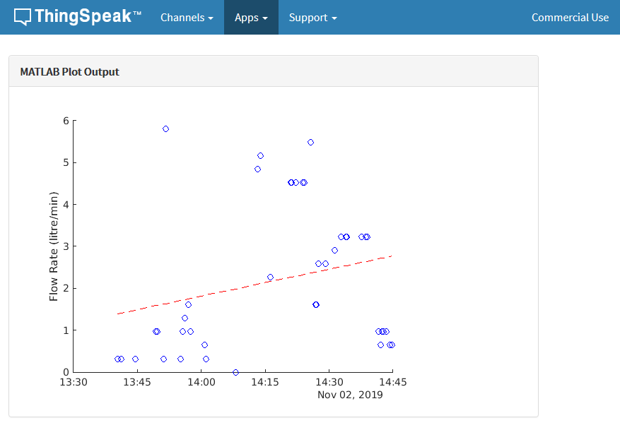
Detailed Work Flow
4. Machine Learning Tools – Linear and Logistic Regression to analyze excessive water flow.
However, the pattern of the water usage is seemingly non-linear in real world applications and thus linear regression turned out not be a good choice.
Linear Regression model used on the historical data to learn flow rates, which is specific for each water meter.

Slide 13
Detailed Work Flow
4. Machine Learning Tools – Linear and Logistic Regression to analyze excessive water flow.
On the other hand, Logistic Regression turned out to provide a much better fit to the data and thus would provide better accuracy to futuristic predictions of excessive water usage from historical patterns of water usage for a meter.
Line graph from actual flow, as recorded by the sensor.
Logistic Regression model used on the same historical data to learn flow rates, which is specific for each water meter.

Slide 14
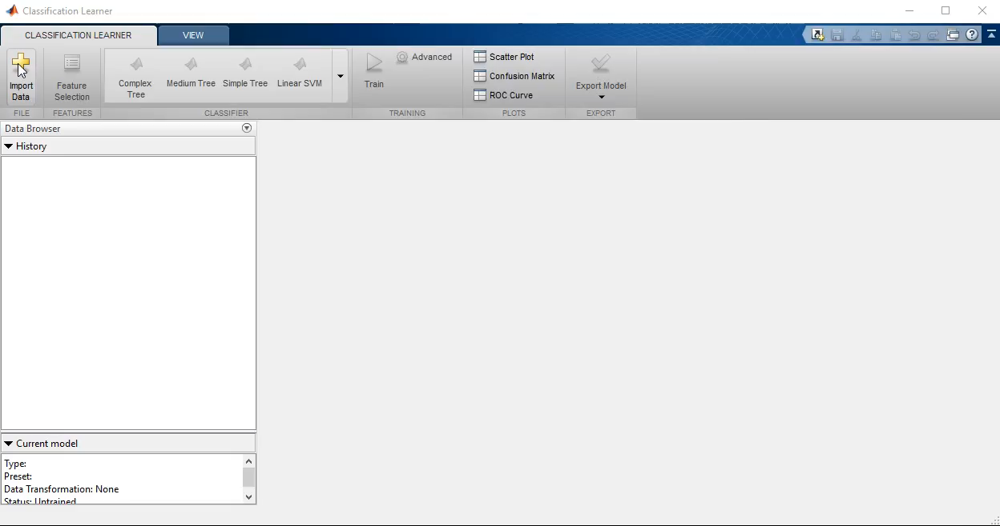
Detailed Work Flow
4. [contd.] Since Logistic regression model requires a classifier set, we need to be able to generate this using historical data. We have tested a few machine learning models on some sample data and the Linear SVM model has given the most accurate results. Hence, we have used the linear SVM model to generate a classifier to be used by the logistic regression technique.

Slide 15
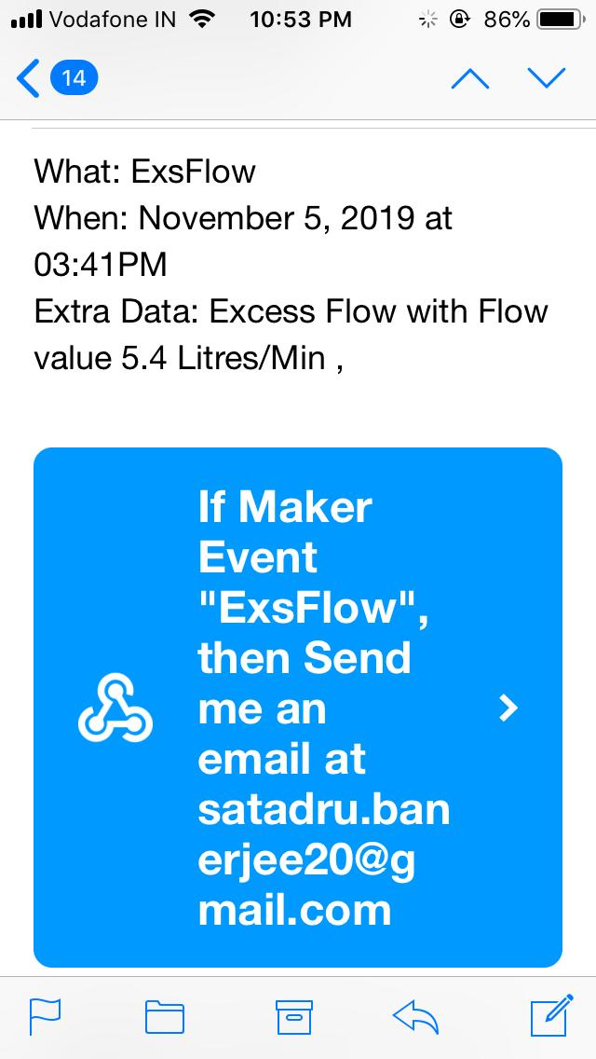
Detailed Work Flow
4. Triggering alerts to concerned users through email notifications.
Multiple users can be notified as per need, as well as to the concerned authorities.
Herein, we deploy the WebHooks services with IFTTT platform to alert the concerned group of users.
5. Execution and ordering of all these codes for analysis and visualization can be easily controlled by the ‘Time Control’ feature of the ThingSpeak Cloud platform which allows to trigger each program on the data that is acquired continuously as per the desired time intervals.
Alert received by the concerned user for excessive water flow through email

Slide 16
What is the USP?
Low infrastructural cost, as only NodeMCU and the water flow sensor was used in recording, visualizing and analyzing the water flow patterns.
Server less Architecture ensures reliability of the data once recorded in the cloud. We deploy the use of Cloud Computing for recording, visualizing and analyzing flow patterns and generation of alerts.
Reliability and Accountability of visualization and analysis of the data very high as Cloud Computing is used.
Ease of Access very high as we deploy the entire processing of data in Cloud Computing domain, which allows users to visualize data from any corner of the world at any time.
Secured, as only authorized users can login and view the data they are authorized to view. ThingSpeak, a platform designed by MathWorks is quite prompt in this domain.
Cost of Cloud Computing not very high as ThingSpeak cloud is relatively cheap compared to others in this domain, as it will allow enormous amout of data to be processed at low cost.
Excessive water flow is notified both on immediate historical data and also learns from it to predict such anomalies in the future.
Self-Sustainable, as if required, we do make use of solar panels, in case access to electricity is poor.

Slide 17
Risk, Issues and Mitigation plan
1. At times, the water pipelines may be buried deep inside the architectural design of the building, then it may get difficult in connecting the water meter there.
Mitigation: For such an event, we may need to monitor through some other pipes, like the ones coming out of the storage tanks, etc. wherein at times, we may need more meters than just one.
2. If there is a pipeline fault, it may qualify as a false positive result for continuous and excessive water usage.
Mitigation: Need to develop a mechanism to detect that by monitoring the time interval of its flow, whose pattern can be learned through repeated usage.
3. Failure to get internet (network) connectivity, for which the data may not be pushed up into the cloud.
Mitigation: Need to have a local storage of the flow rates and push it back to the cloud once internet connectivity is restored.
4. Intentional/Environmental disconnection of the internet connectivity and damage inflicted to the meter.
Mitigation: Deploy some individuals to investigate such occurrences.

Slide 18
Revenue Plan
Implementation of a water usage monthly billing system.
This can be implemented as we have already calculated the amount of water used by a particular household, within a given time frame, which will be monthly for a monthly billing system. Our billing model is based on the one already implemented in the Chennai metropolitan area by the Tamil Nadu State Government.
The monthly bills can be generated as per the timings set in the ‘Time Control’ section of the ThingSpeak cloud platform.
It will be easy to generate as all the data will be available on the cloud platform.
Cost to maintain such a system will be quite less, thus it can help maximise profits.
Performing a survey, in favour of the government, to analyse water flow patterns and water consumption data across India. Will assist in better planning and distribution of water resources. Will also help detect and prepare in advance, for severe water shortages.

Slide 19
Revenue Plan: Unit Cost
Each domestic meter has an unit cost of INR 1200. Industrial meters, requiring higher capacity sensors, more powerful processors and extensive fabrication will cost INR 2500.
Users will lease the unit for a monthly payment of INR 60. The unit must be returned in working condition or a penalty of INR 800 is levied.
Commercial meters will be leased at INR 200 per month.
After a period of approximately two years, per unit profit increases as meter cost is recovered completely.
Item | Expenditure(INR)
Meter components | 900
Fabrication charges | 100
Maintenance and Infrastructure charges | 200
Subtotal | 1200

Slide 20
Revenue Plan: Domestic Users
Category | Qty of water | Rate/KL in Rs. | Minimum Rate Chargeable (including sew charges)in Rs. | Frequency of billing
Domestic Residential premises (Single buliding/ per apartment for block of apartments) | Upto 10 KL | 4.00 | Rs.80/- per month per dwelling unit | Monthly
 | 11 to 15KL | 16.00
 | 16 to 25 KL | 24.00
 | Above 25 KL | 40.00

Slide 21
Revenue Plan: Commercial Users
Category | Qty of water | Rate/KL in Rs. | Minimum Rate Chargeable in Rs. | Frequency of billing
Private Hospital | upto 500 KL | Rs.103/KL. | Rs.1694/- * (Water Intensive) | Monthly
Private Hospitals | above 500 KL | Rs.169/KL. for entire quantity. | Rs.1694/- * (Water Intensive) | Monthly
All others | Upto 500 KL | Rs.73/KL. | Rs.1452/- * (Water intensive) | Monthly
All others | above 500 KL | Rs.132/KL. for entire quantity | Rs.1452/- * (Water intensive) | Monthly
Industry | Upto – 500 KL | Rs.73/KL | Rs.787 /- (Water intensive) | Monthly
Industry | above 500 KL | Rs.145/KL for entire quantity | Rs.787 /- (Water intensive) | Monthly

Slide 22
Revenue Plan
Item | Domestic | Commercial
Usage charges (p.m) | 60 | 200
Cost towards meter | 50 | 100
Monthly income(per 1000 units) | 10000 | 100000
Monthly income after meter cost recovery (approx. 2 yrs) | 60000 | 200000

Slide 23
Thank You
We will take your questions now

